Slide 1
Advanced Systems Analysis and Design Process Modelling SOFT 30121 L8

Slide 2
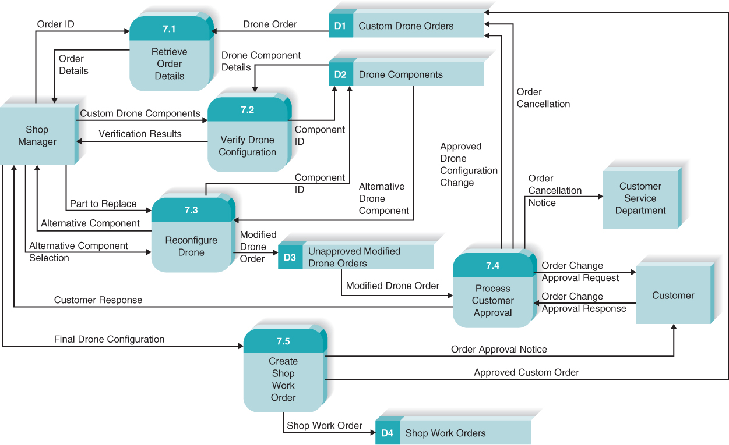
Process Modelling
RecoSystems Analysis and Design
Alan Dennis; Barbara Haley Wixom; Roberta M. Roth
2019
Chapter 5

Slide 3
Process Modelling
Objectives of Lecture 8
A quick review of diagramming and notation styles for process modelling..
Describe the process used to create data flow diagrams.
Create some business process diagram
Be able to plan the modules you will build
Be able to confirm the planned modules are likely to meet the requirements
Be able to start building estimates for modules
SOURCE: RecoSystems Analysis and Design
Alan Dennis; Barbara Haley Wixom; Roberta M. Roth
2019
Chapter 5

Slide 4
Process Modelling
A process model is a graphical way of representing how a business system should operate
Illustrates the processes or activities performed and how data moves among them
Can be used to further clarify the requirements definition and use cases
If you’ve created really detailed use cases, you might find that process models don’t add much to the understanding of the system. At the same time, if you’re use cases are more casual, process modelling might prove more beneficial.

Slide 5
Diagramming Styles
BPMN – Business Process Modelling Notation
The Business Process Modeling Notation (BPMN) is a graphical notation that depicts the steps in a business process. BPMN depicts the end to end flow of a business process. The notation has been specifically designed to coordinate the sequence of processes and the messages that flow between different process participants in a related set of activities.
Workflow Diagram
A workflow diagram is a visual representation of a business process (or workflow), usually done through a flowchart. It uses standardized symbols to describe the exact steps needed to complete a process, as well as pointing out individuals responsible for each step.
Activity Diagram
UML notation for control flow. An activity diagram is a behavioral diagram i.e. it depicts the behavior of a system. An activity diagram portrays the control flow from a start point to a finish point showing the various decision paths that exist while the activity is being executed.
Data Flow Diagram
A data flow diagram (DFD) maps out the flow of information for any process or system. It uses defined symbols like rectangles, circles and arrows, plus short text labels, to show data inputs, outputs, storage points and the routes between each destination.
Use the style that you are most comfortable with in your submission. We will expand on how to develop DFD’s but any process flow is acceptable.

Slide 6
BPMN – Business Process Modelling Notation
Advantages | Disadvantages
Account for the whole process | Less easily tied to code. (BPEL being an exception to this.)
Easy to review with stakeholders | Join and split notation is a bit hard

Slide 7
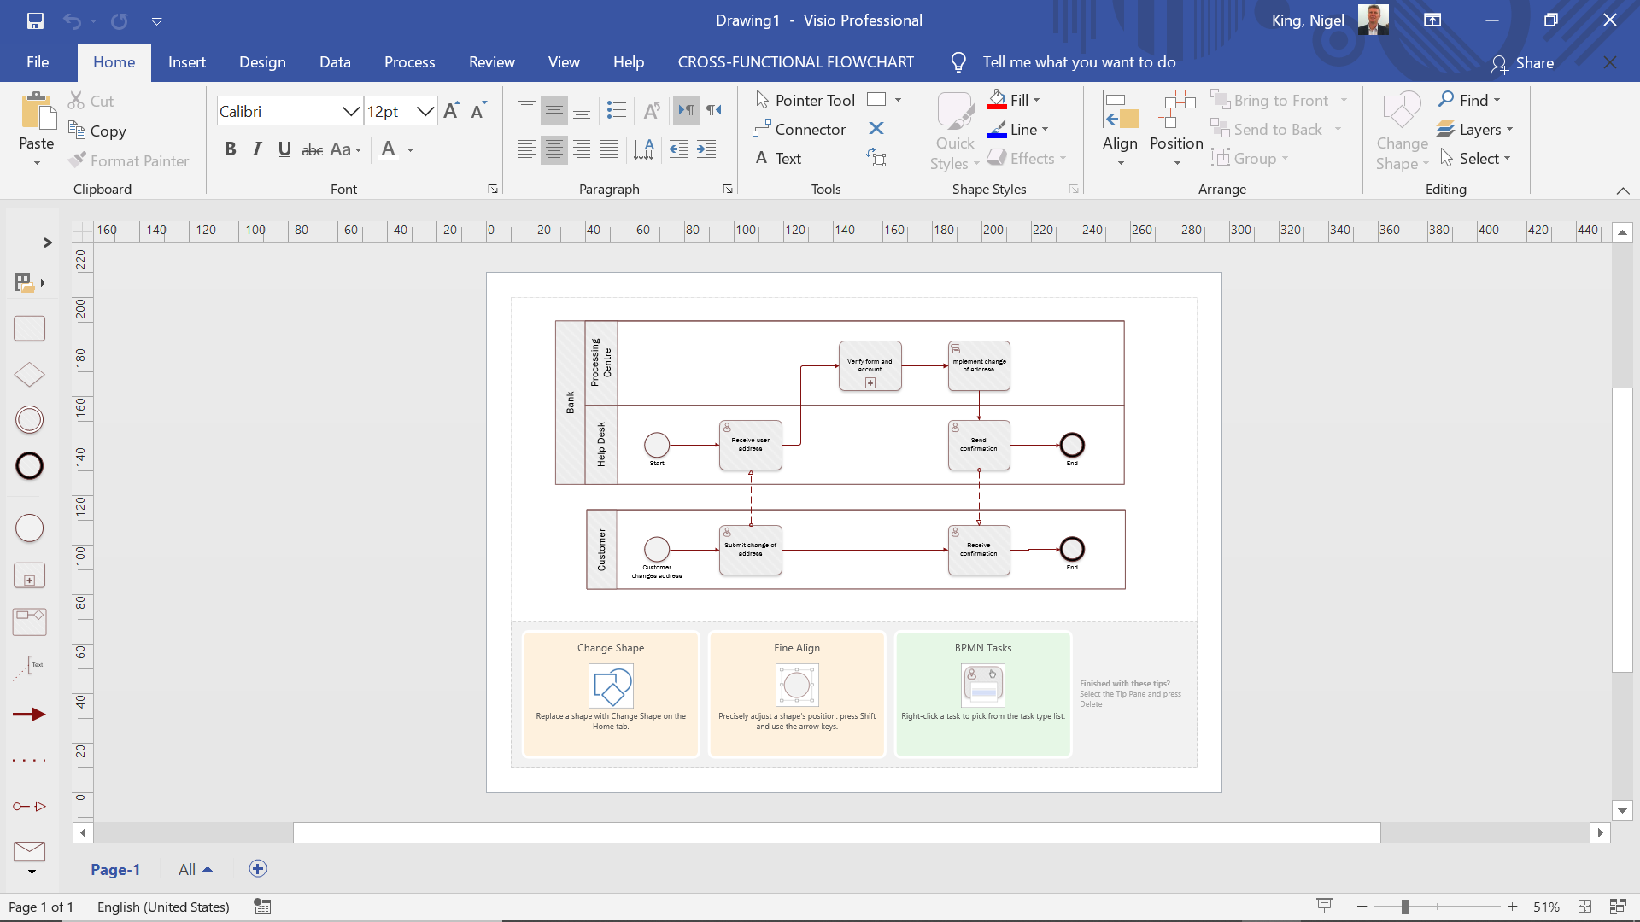
Workflow Diagram in VISIO

Slide 8
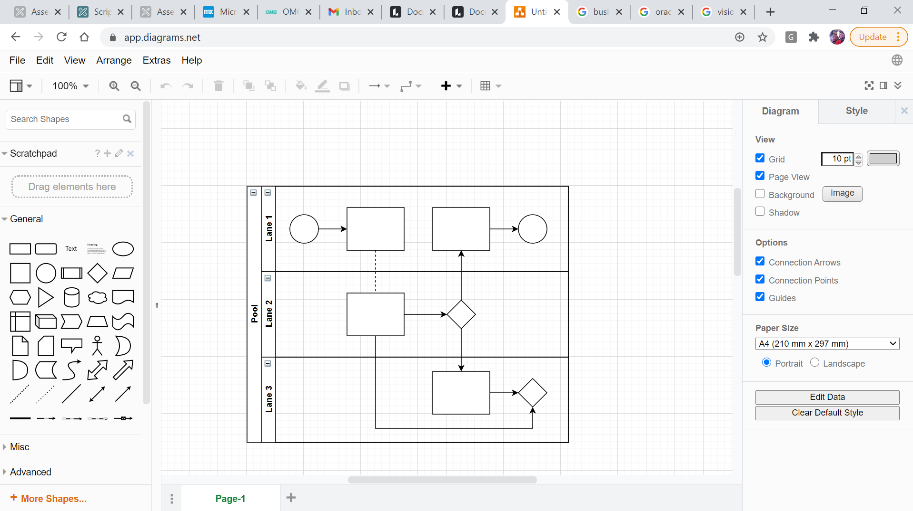
Workflow Diagram in Draw.IO

Slide 9
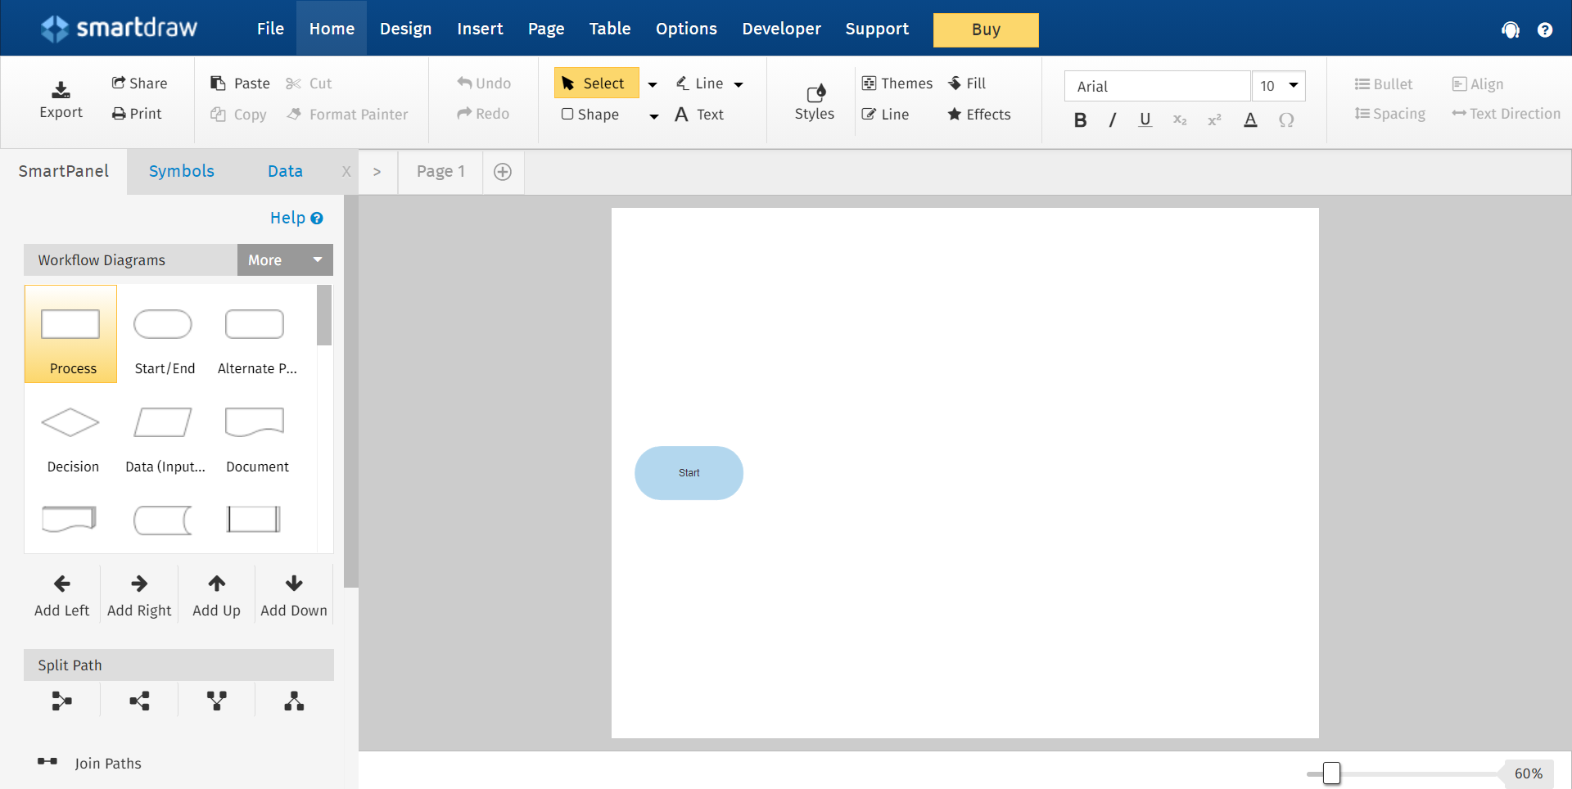
Flow Chart in Smartdraw

Slide 10
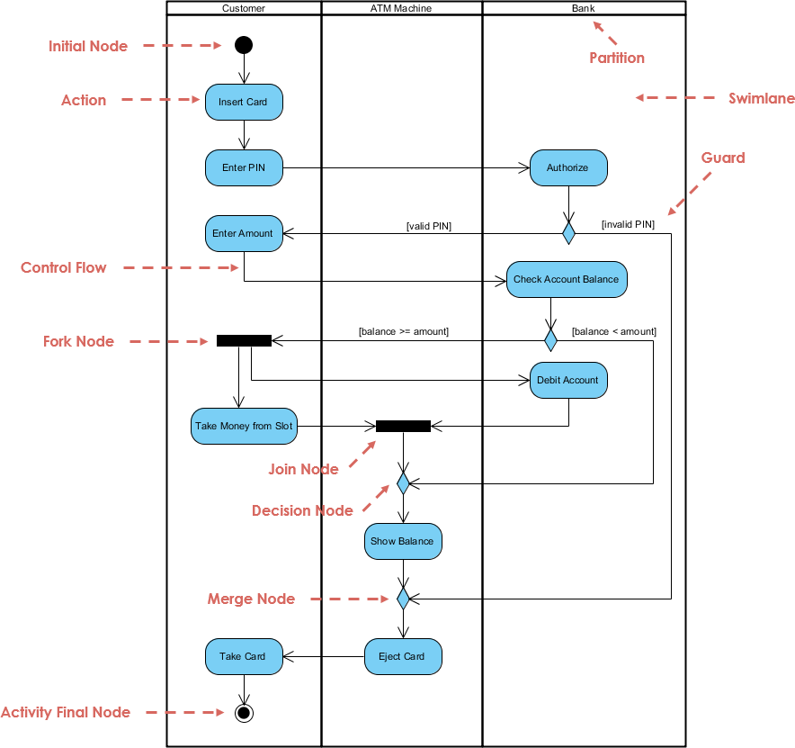
UML Activity Diagram
Advantages
More closely linked to code.
Engineers understand it better
Disadvantages
Less obvious how non system parts of a process fit.
Harder to review with stakeholders.

Slide 11

Nigel’s general experience
Data flow diagrams are a bit lower level than BPMN and Workflow.
The left to right, top down temporal and dependency flow inherent in BPMN and Workflow is crucial to understanding the process.
Finding people that have enough technical aptitude to work through a data flow diagram but would not prefer to be coding is quite rare.
I generally work from a process diagram, and will cross check and confirm that my requirements are accounted for in my process flow.
In data flow diagramming you are expanding on a use case as a method for confirming all requirements are met
My process flow will generally give me a good indication of UI’s and Batch programs I need to create.
Data Stores give me a good indication of class and tables.
Note the active verb at the start of each process. <Verb><Noun> phrasing is very good.

Slide 12
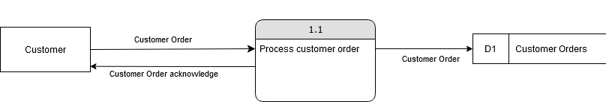
Data Flow Diagrams
-To aid readability, DFDs often start in the top/left.
-The arrows indicate that one entity provides a “bundle” of data to another entity.
-These bundles are listed as major inputs in the use case.
-Open ended rectangles (Like D1) represent data stores.
-Important rule: Every major output on your use cases should flow out to either an external entity or a data store.

Slide 13
Diagramming mistakes
Black holes: Where a processing step has input flows but no output flows
Miracles: Where a processing step has output flows but no input flows
Grey holes: Where a processing step has outputs that are greater than the sum of its inputs.
In short… Make sure your outputs match your inputs!

Slide 14
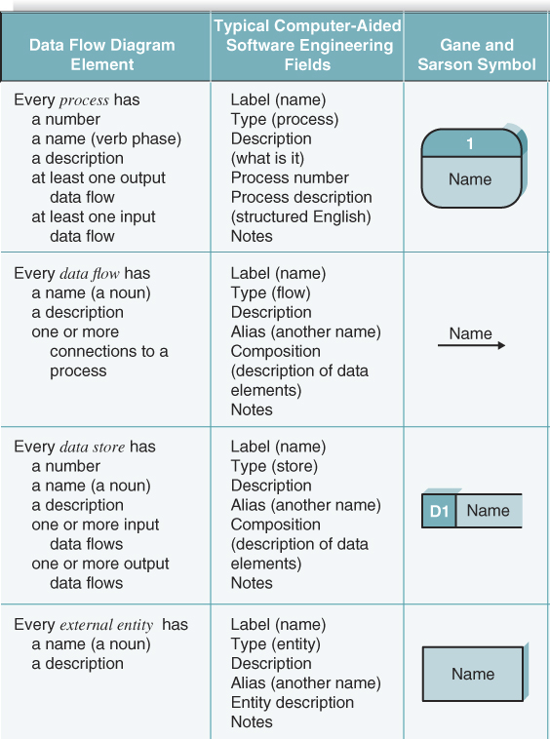
Diagram elements

Slide 15
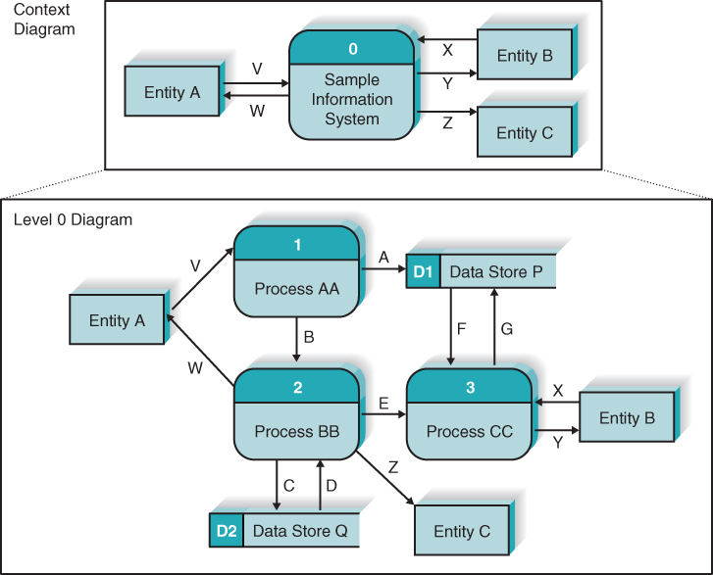
DFD Hierarchy
DFDs can be decomposed into a hierarchy of DFDs, each level down consisting of less scope but more detail.
Context diagram: Shows the entire system in context with its environment.
Level 0 Diagrams: Shows all major processes at the first level of numbering.

Slide 16
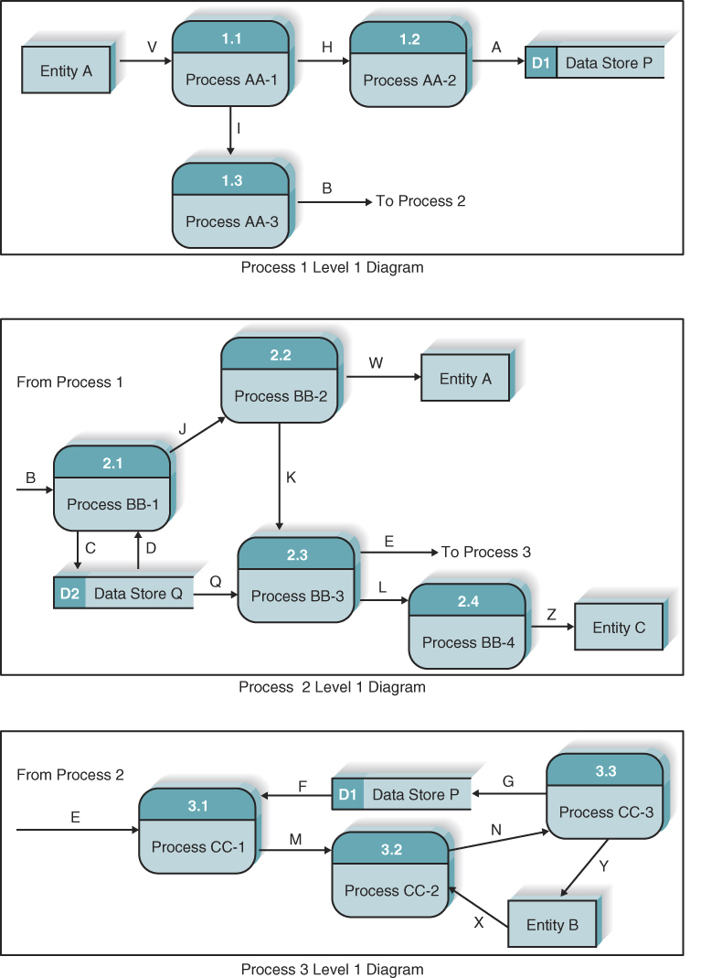
Level 1 Diagrams
Shows how the each of the main high-level processes in the system interact
Each component of the level 0 diagram should have its own level 1 diagram.
The data flows between entities should be balanced (in the same way the level 0 was).
The context diagram, the level 0 diagram, and the top level 1 diagram all show process flow V from entity A
The external entities should be shown on all levels of diagram.

Slide 17
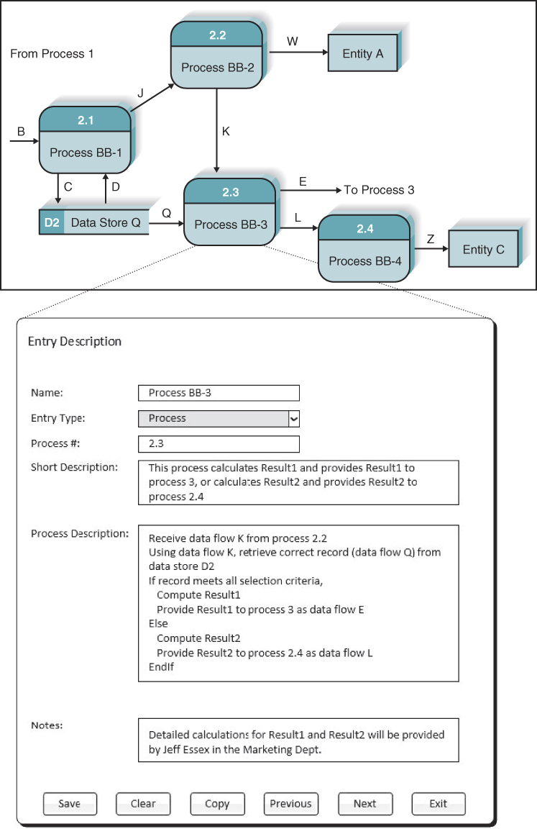
Process descriptors
What happens when a process produces different flows under different circumstances? How do we show alternate paths in the DFD? We need to show both, and use process descriptions to explain that they are alternatives.
Process descriptors explain what the process does, and provide additional information otherwise not on the DFD
Structured English, decision trees, and Decision tables are three techniques commonly used to describe more complex processing logic in process descriptors

Slide 18
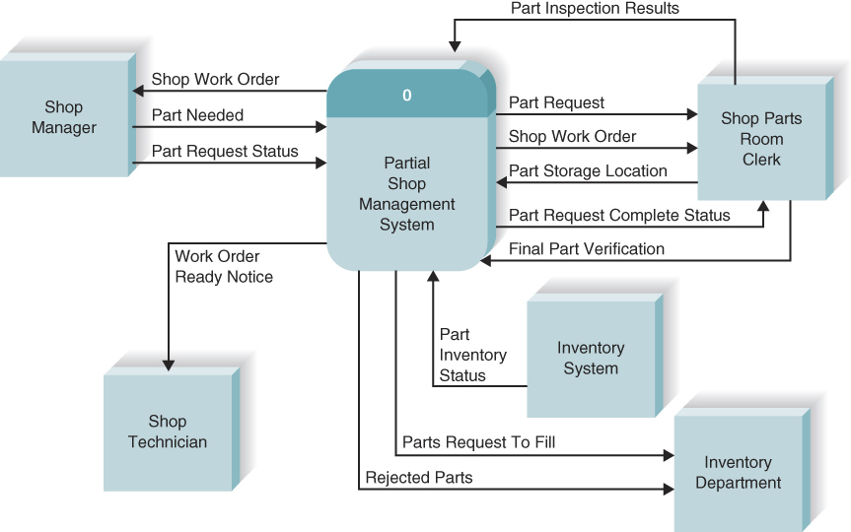
Creating the context diagram
Read through the use cases and populate the diagram with the inputs and outputs listed, as well as their sources and destinations
These will likely be external entities such as a person, organisation, or other information system
At DronTeq
3 use cases are focused on here: Create parts request, Record Receipt of component, and Finalise parts request

Slide 19
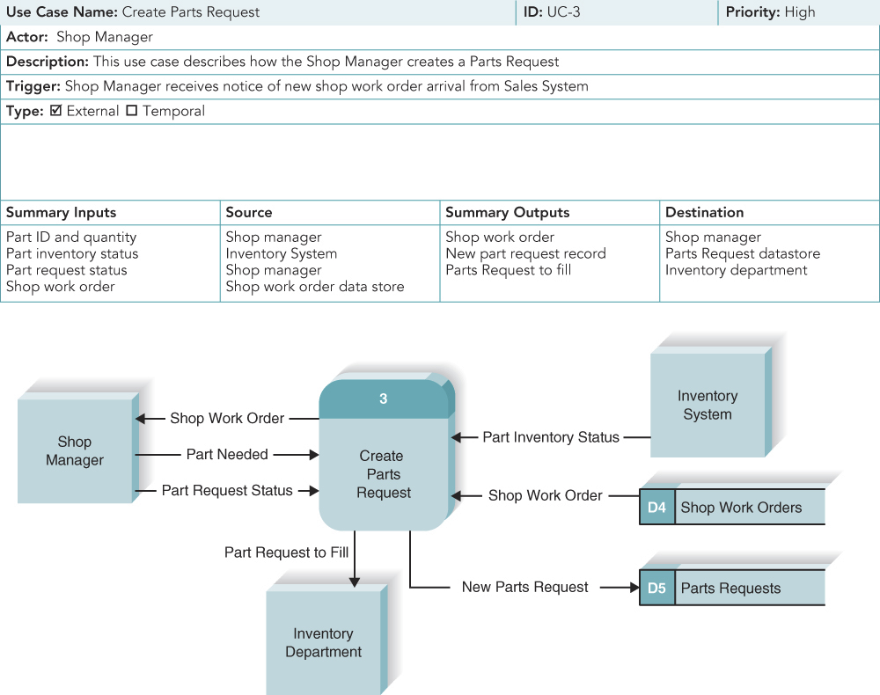
DronTeq Create Parts Request fragment
Each use case is converted into a DFD fragment.
Normally the ID number on the use case corresponds to the number on the DFD fragment
DFD process names must be a verb phrase, so these might change from the use case

Slide 20
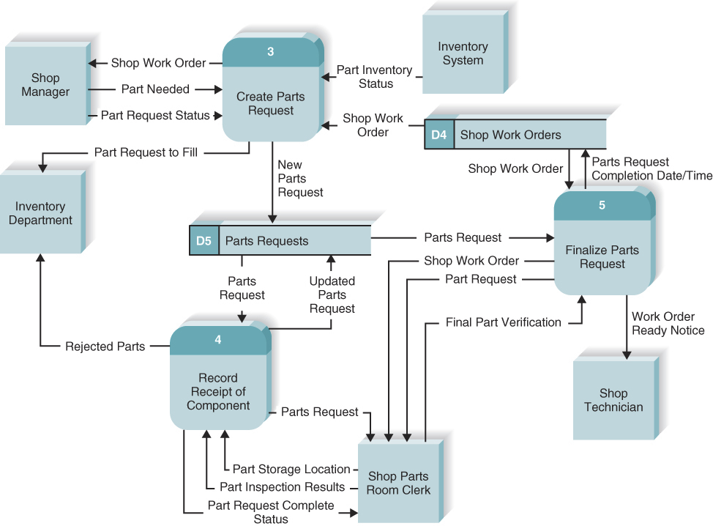
Create the level 0 diagram
Now we have fragments for each use case, we can combine these into the level 0 diagram.
There will be a lot more data flows here, it’s important that it’s easy to understand:
Try to minimise the number of dataflows that cross
Put the process that is first chronologically in the upper left corner to aid readability

Slide 21
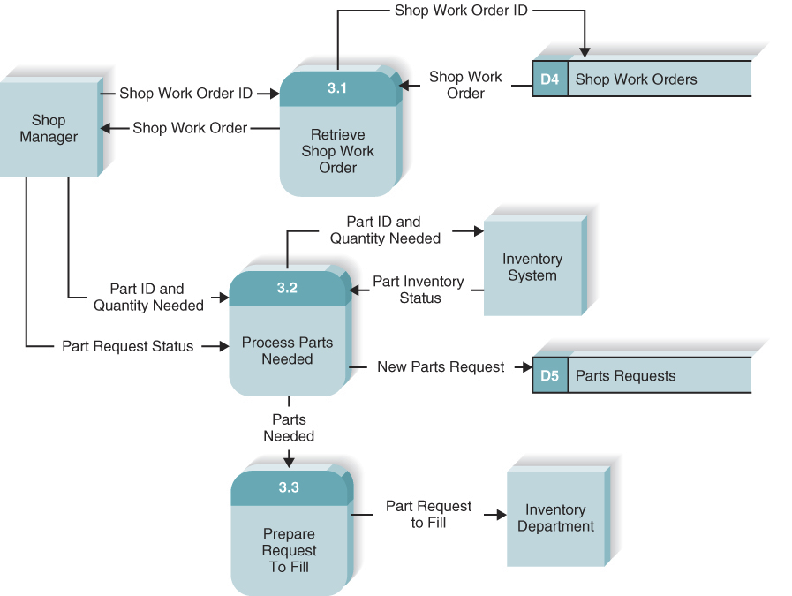
Create the level 1 diagram (and below)
Each one of the use cases is now turned into it’s own DFD
Usually, each major step on the use case becomes a process on the level 1 DFD
Since you are now thinking more deeply about how the processes will be supported, it is normal for the use cases to change
When should you decompose a process on a level 1 diagram to a child diagram? One rule of thumb is that each lowest level process should be no more complex than what can be realised in 25-50 lines of code

Slide 22
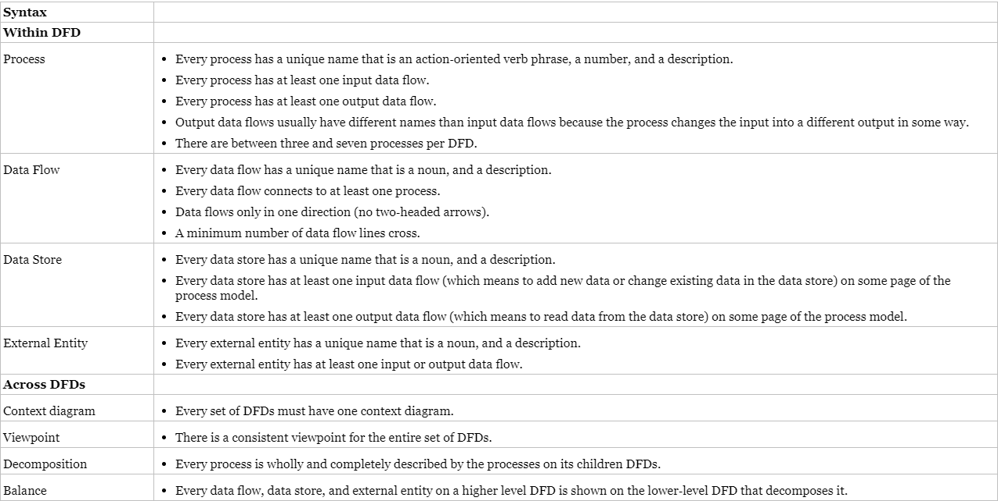
Validating data flow diagrams
Syntax errors refer to whether the DFDs follow the rules of the DFD language

Slide 23
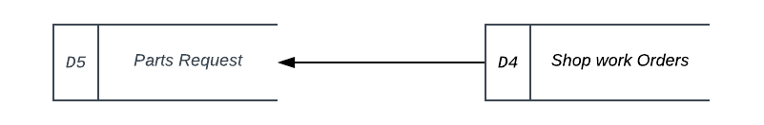
Validating data flow diagrams
The most common syntax error that novice analysts make is violating the law of conservation of data
“Data at rest stays at rest until moved by a process”
Data cannot move without a process. The following is incorrect:
“Processes cannot consume or create data”
This refers to the black hole and miracle rules referred to earlier
Some more common mistakes are on the next slide…

Slide 24
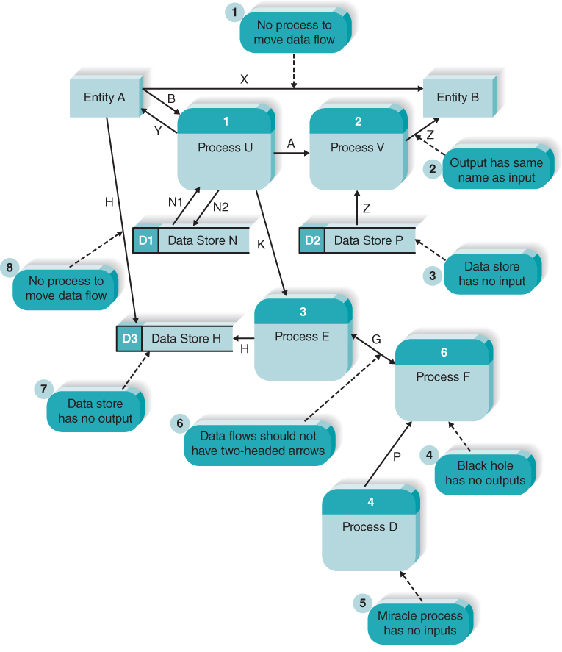
Validating data flow diagrams

Slide 25
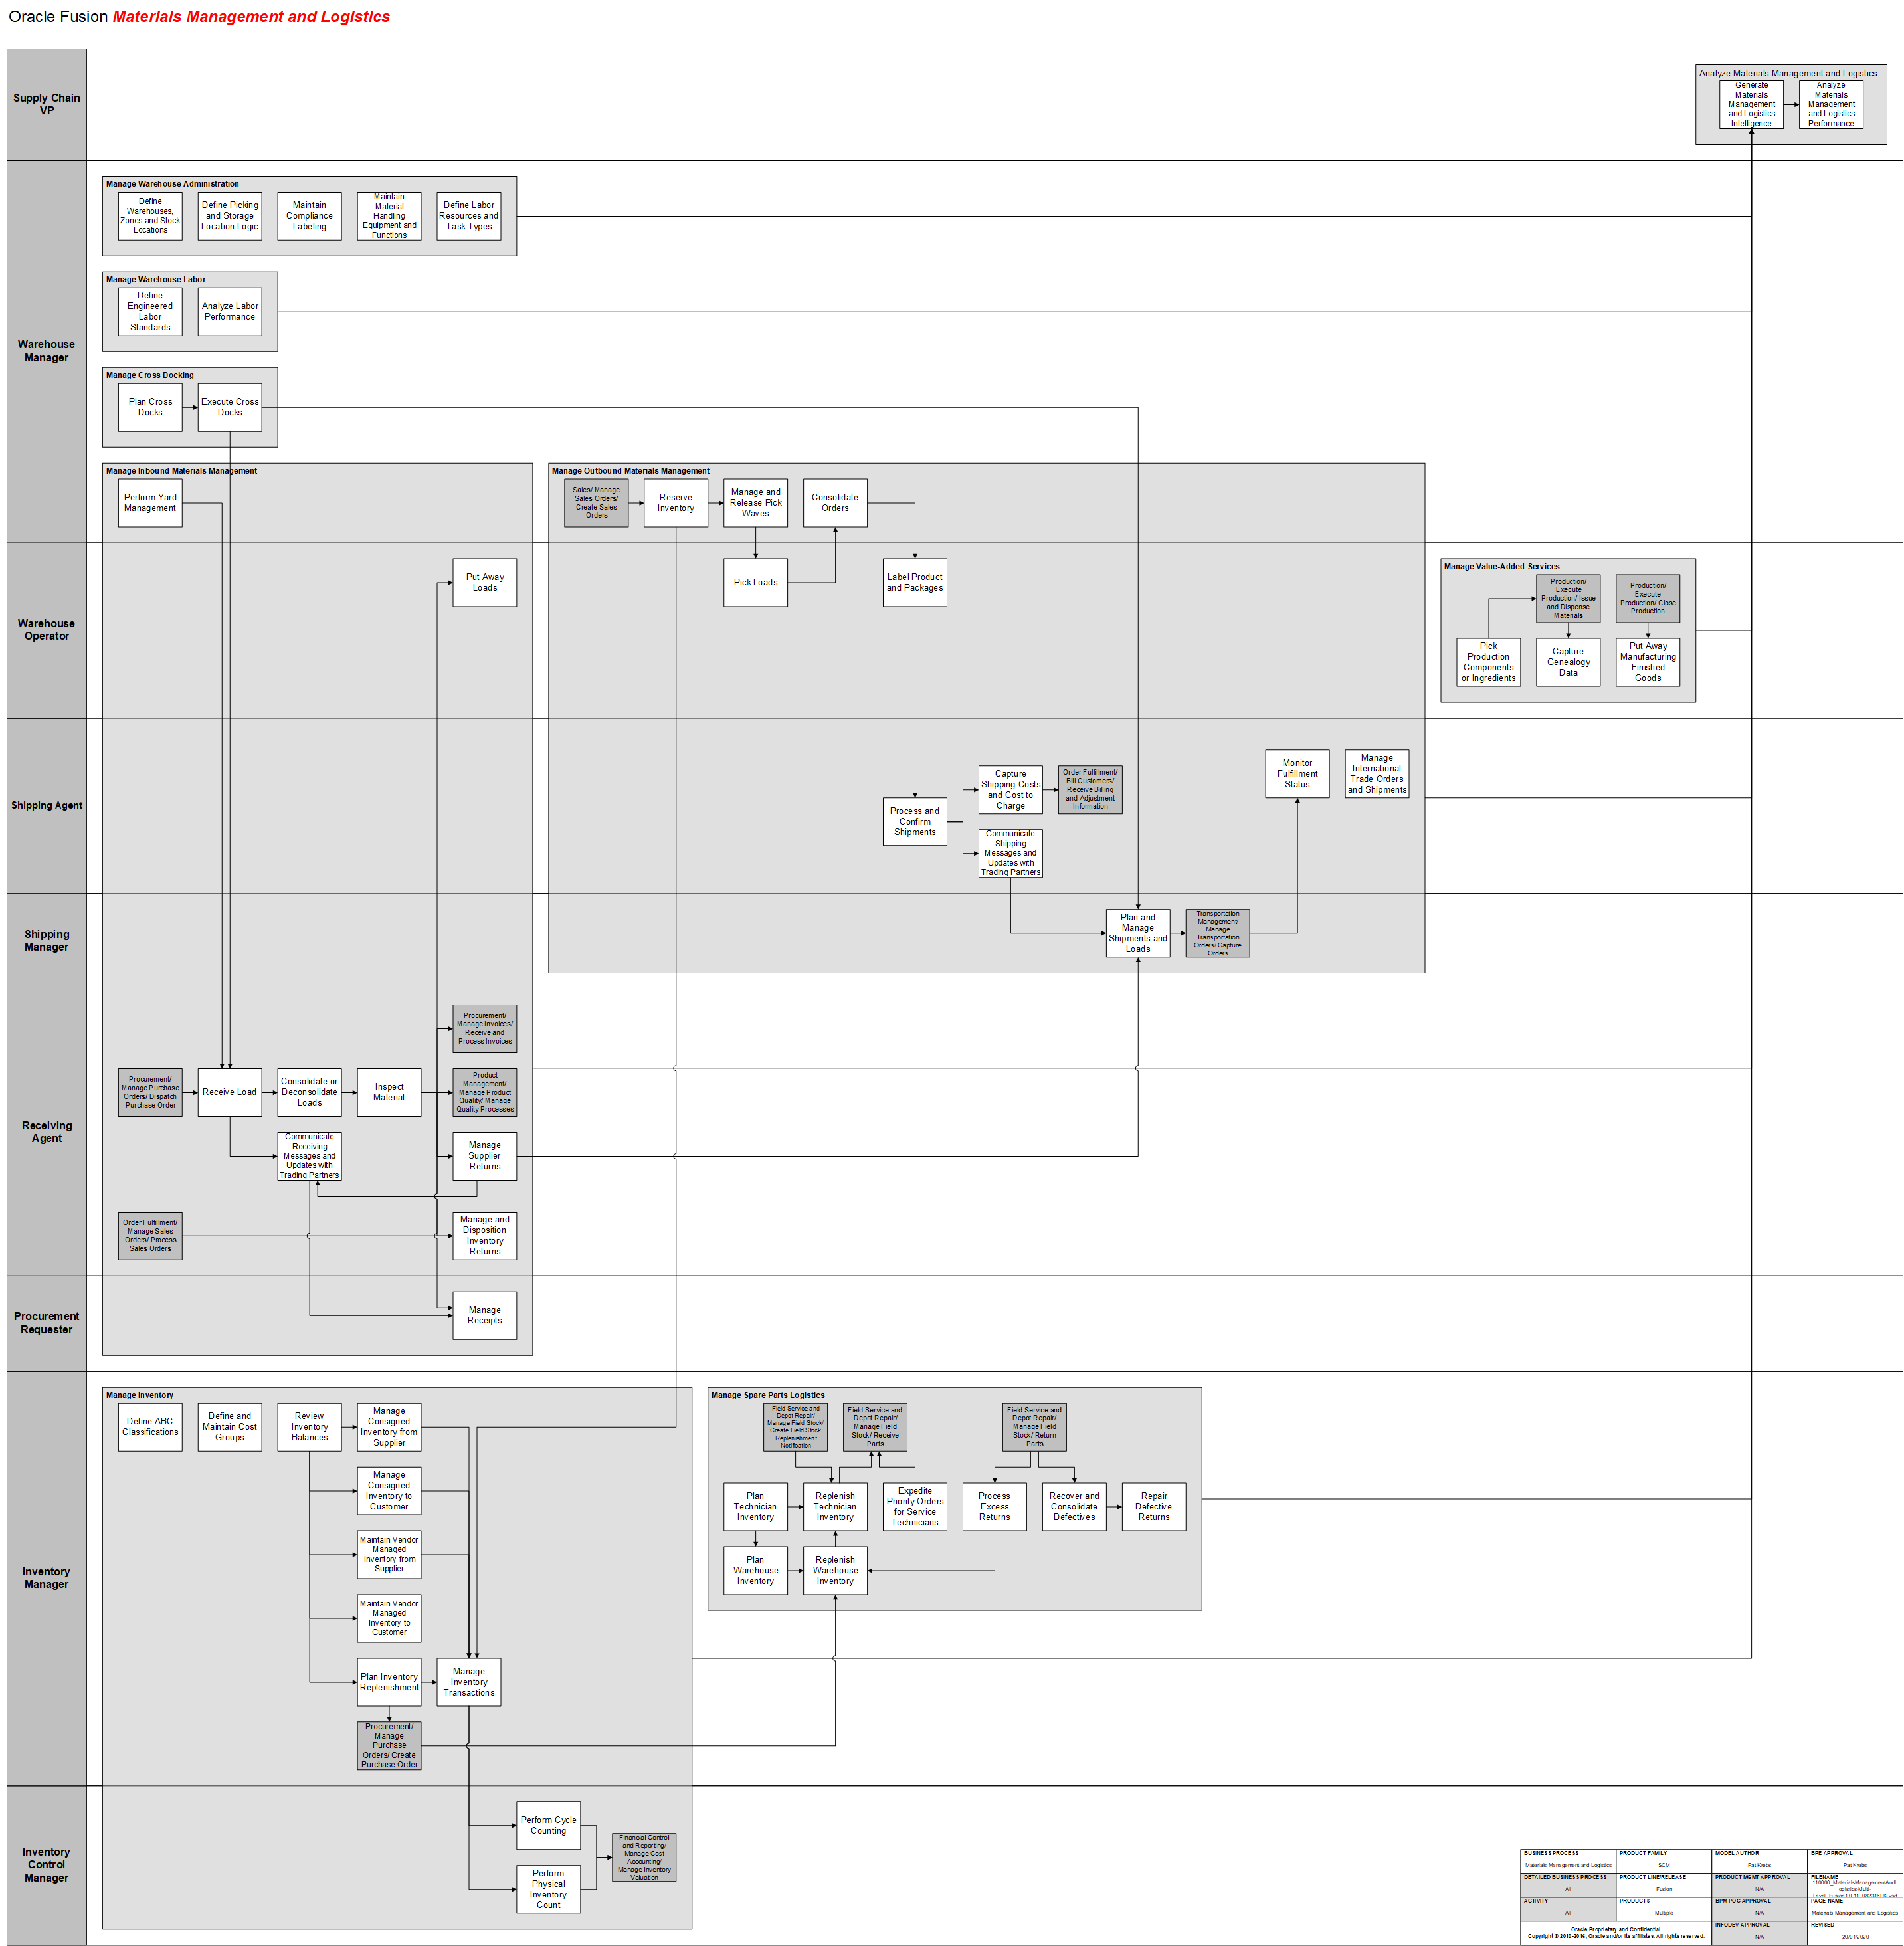
An Oracle Applications Example

Slide 26
Validating data flow diagrams
Semantic errors can be thought of as misunderstandings by the analyst in collecting, analysing and reporting information about the system
These are a bit harder to find/fix, so cause more problems. Three useful checks help ensure the model is semantically correct:
Is the model an Appropriate representation of the system? Check this by walking through the system with potential users
Ensure consistent decomposition. All processes should be decomposed to the same level of detail (this is not the same as saying they should be to the same number of levels)
Ensure consistent terminology. Things may have different names in different parts of the organisation. “sales order” vs “customer order”

Slide 27
Next Lecture
Data Modelling

